Slide 1
Columns and bars
Columns and bars

Slide 2
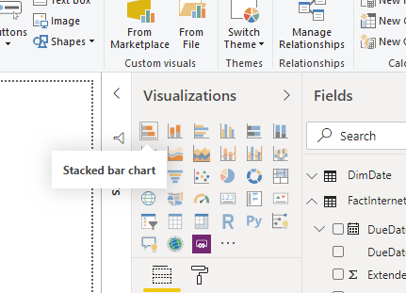

Columns and bars
Note: This exercise requires the database
Import the DimDate and FactSales paintings from the Sales.xls of Excel Sources Folder
In the Visualizations area , try hovering over the first 5 items

Slide 3
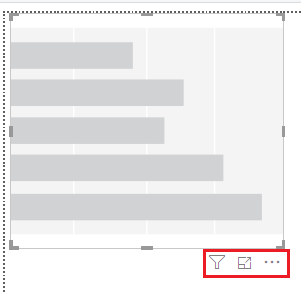

Columns and bars
Add the stacked bar chart visualization to the scene and try to discover the icons located just at the bottom right
There is the filter functionality , the focus function and the spot function .

Slide 4
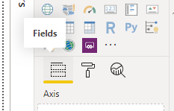
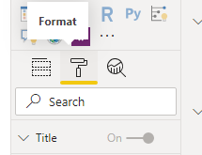
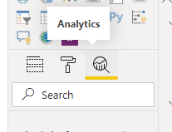
Columns and bars
Note the following only three sections under the Visualizations section at the bottom

Slide 5
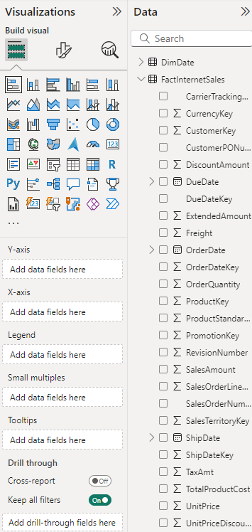
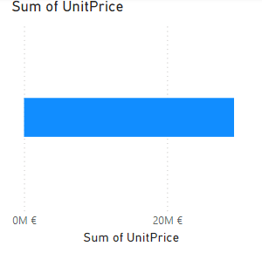
Columns and bars
Unit price field from the Fields section of the FactInterntSales table to the X axis

Slide 6
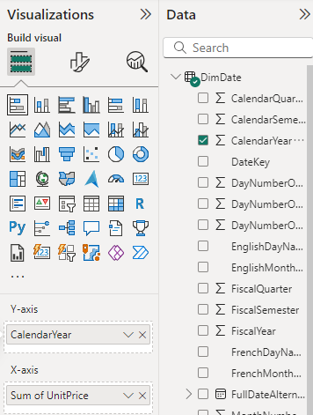
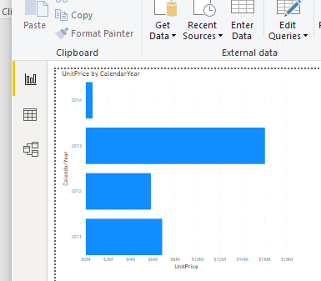
Columns and bars
Drag the calendar year Since DimDate at Y axis level field from DimDate painting

Slide 7
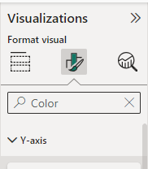
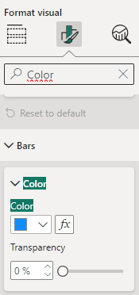
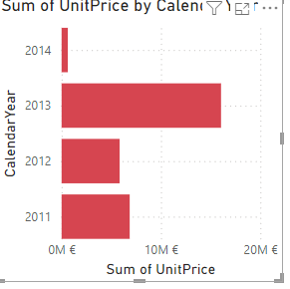
Columns and bars
Type Color in the search bar in the Format section
To try change the color of the bars to red
Type the text and try to change the text features

Slide 8
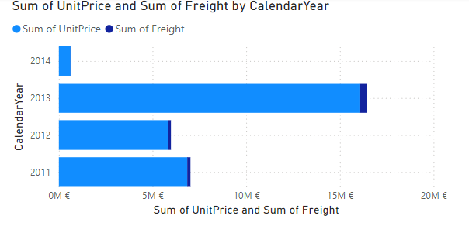
Columns and bars
Develop visualization
Freight field to X axis parameter
Note that the visualization changes

Slide 9
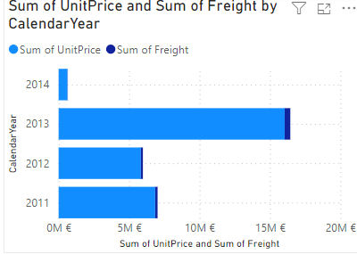
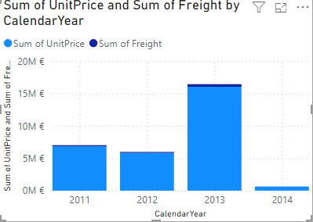
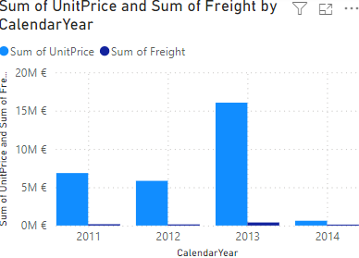
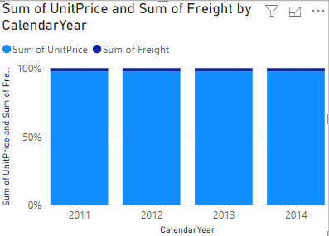
Columns and bars
Select the visualization and try changing the visualization type by selecting a column or bar visualization type each time
Remove freight​ field and and add Name of the month in English to the legend
Select the Analytics area , then add a constant line

Slide 10
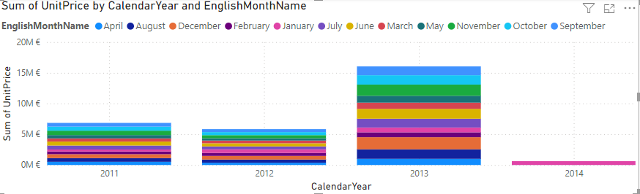
Columns and bars
Select the visualization and try changing the visualization type by selecting a column or bar visualization type each time
Remove freight​ field and and add Name of the month in English to the legend

Slide 11
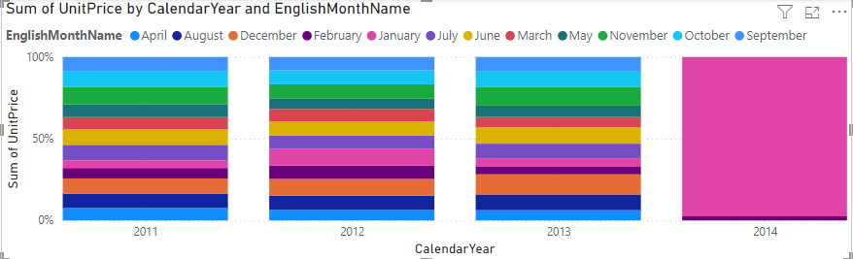
Columns and bars
Change the visual type to 100% stacked Type

Slide 12
Thank you
Thank you

